Slide 1

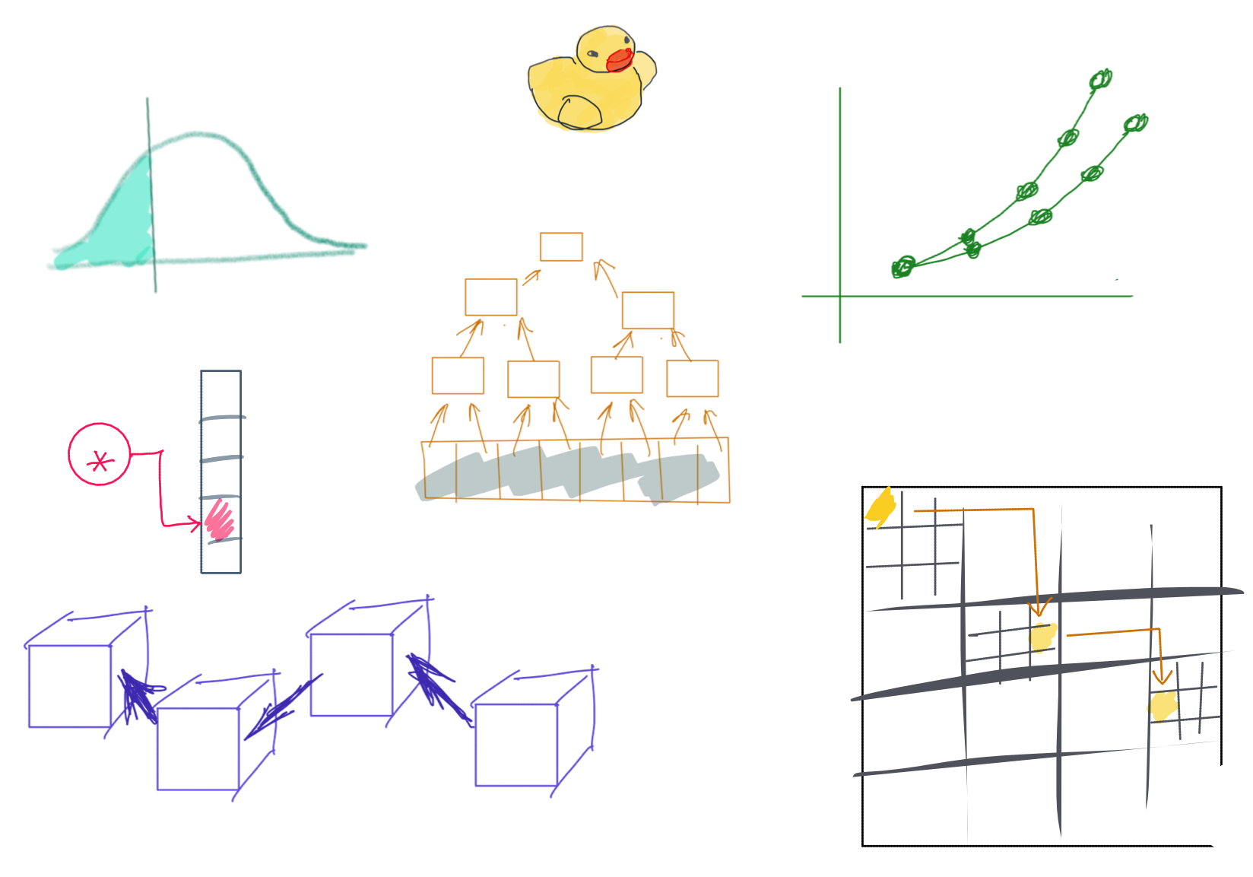

Slide 2
CSS342 Data Structures, Algorithms, and Discrete Mathematics (I)

Slide 3
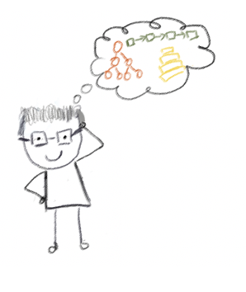
Lecturer
Peng Du
High performance computing
Matrix Factorization, etc
Cloud & Edge computing
Kubernetes, docker, etc.
Teaching
CSS 342 & CSS 143

Slide 4


Why “goose”?
https://www.instagram.com/fatgoooose
https://github.com/a-teaching-goose
Comic design and drawing by @percima.art

Slide 5
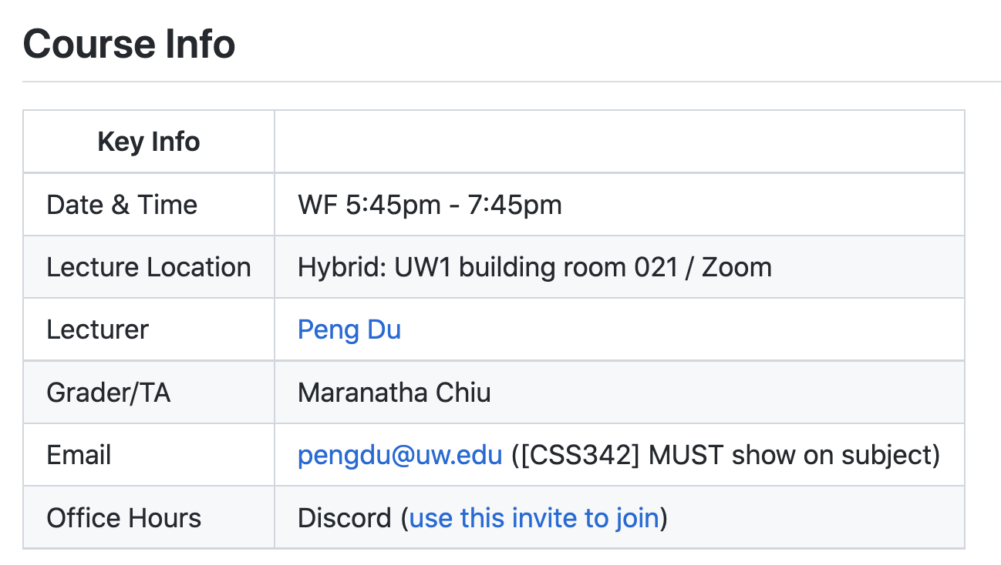
Class Info
Syllabus
https://github.com/a-teaching-goose/CSS342A-2022-Spring

Slide 6
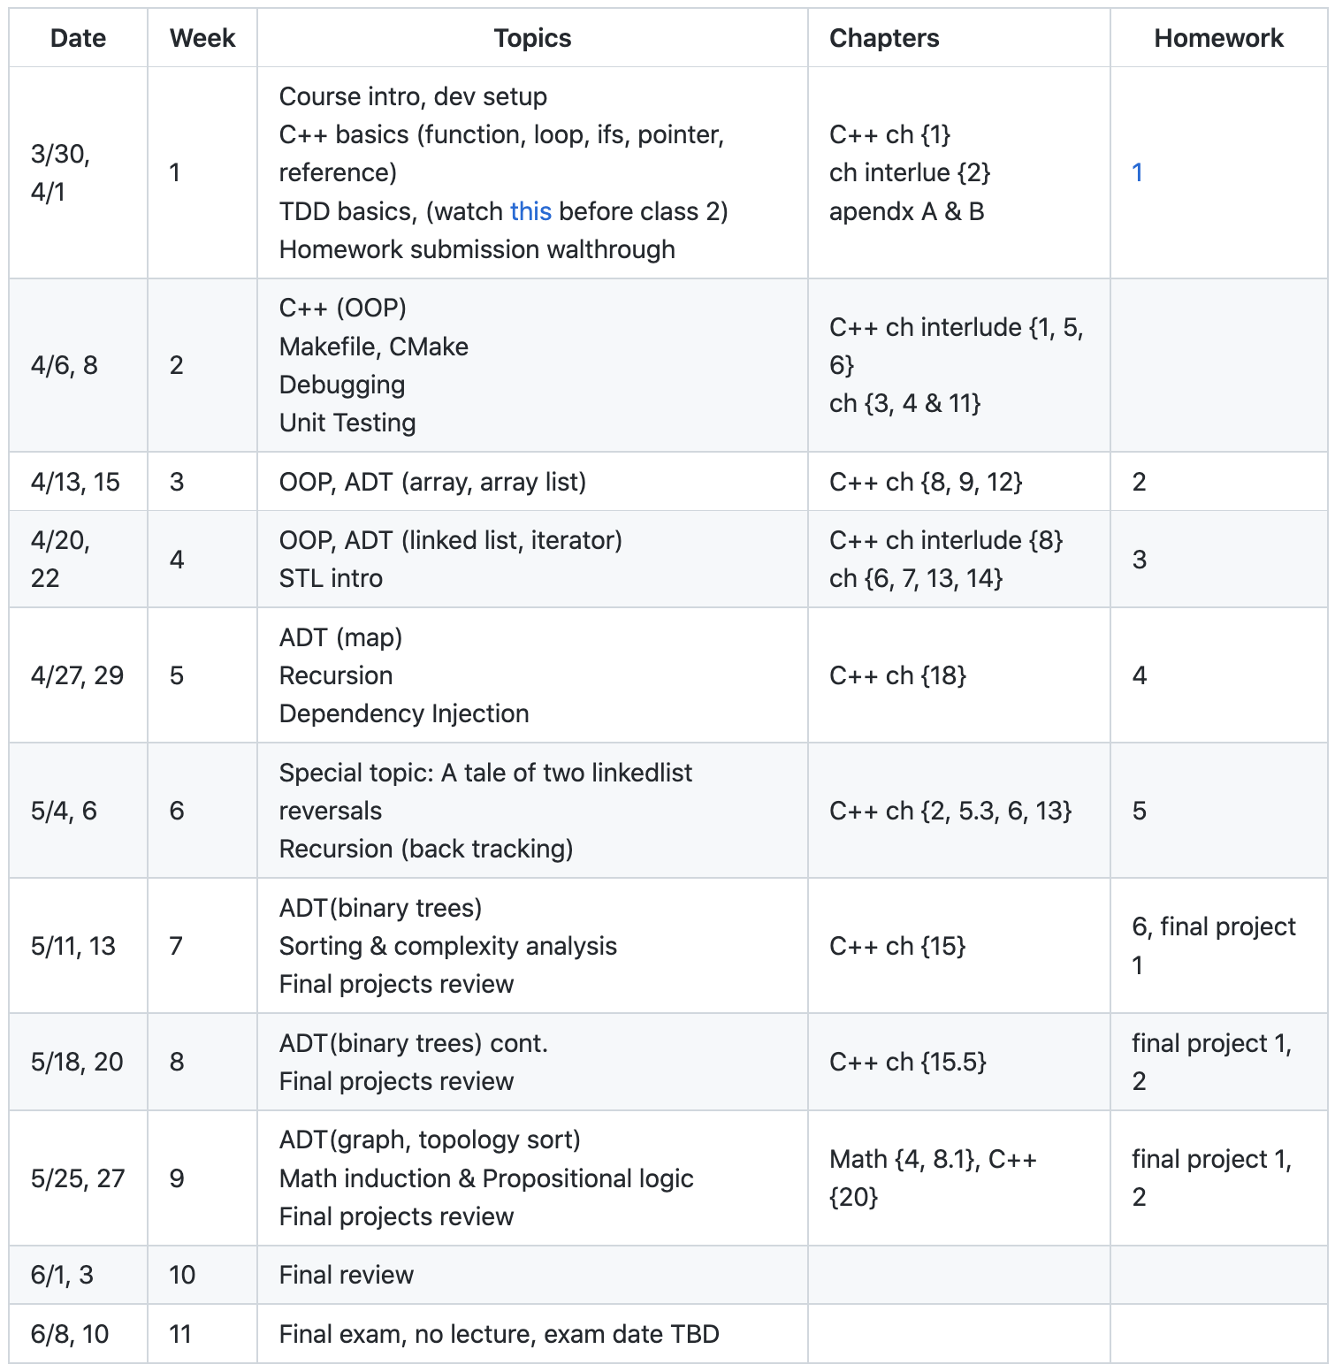
Class Info
subject to change
https://github.com/a-teaching-goose/CSS342A-2022-Spring#tentative-schedule
How do I know though?

Slide 7

Class Info (the fun stuff)
Special topic: A tale of two LinkedList reversals

Slide 8
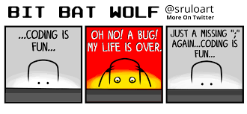
Class Expectation
After this term, you will
Be confident writing code in C++ with cool tools such as Clion, CMake, Makefile
Be confident with using source control tools Git and Github
Write clean code with solid tests
Have good understanding of data structure such as array, hashtable, list, tree
Understand how to compromise between time and space complexity
Have solved many technical problems commonly asked during interview
Have written your own text search engine web app (Watch out! Google!)
(hopefully) Have fun

Slide 9

Homework, Tests, Exams
Weekly homework
15-min Quiz, mostly coding question
2 midterms
1 Final
No late assignment will be accepted
Exception is very very rarely given
No make-up exam

Slide 10
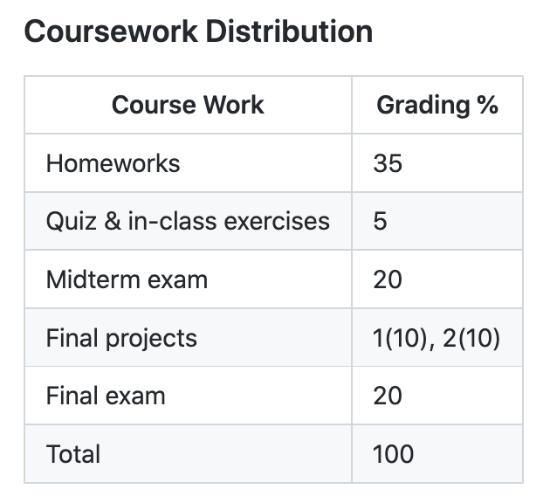
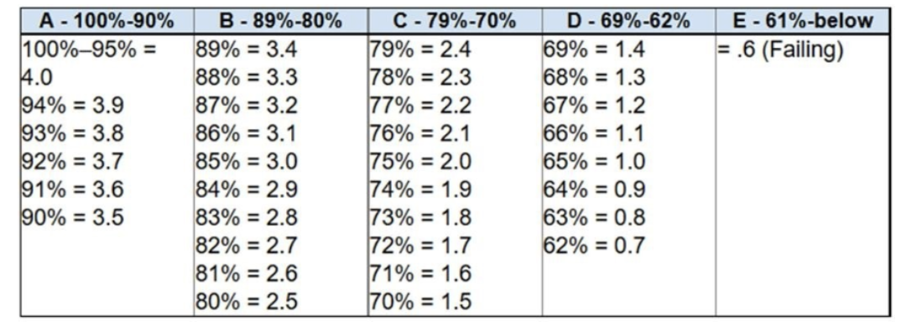
Grading
https://github.com/a-teaching-goose/CSS342A-2022-Spring#coursework-distribution

Slide 11

Plagiarism
Do the work yourself
It’s okay to get help from other people’s work/idea/code, but:
Give credit : “I was using […] for help in this homework”
Do not copy & paste (checked by grader)
Violation will be reported to department
School takes this VERY VERY seriously

Slide 12
Is it Plagiarism?
Case 1:
Stuck for 2 hours. Found answer on stackoverflow.com. Copy answer into homework without changes and submit.
Plagiarism!!
Instead, understand the idea from the help source, and then write the code yourself. Better yet, make some improvement.

Slide 13
Is it Plagiarism?
Case 2:
Had discussion with friends, classmates, TA and/or instructor. Write code based on your understanding.
NOT Plagiarism!!

Slide 14
Is it Plagiarism?
Case 3:
Ask homework at paid-for-help service, someone there wrote the code, and you paste that code into submission
Plagiarism!!
Instead, understand the idea from the help source, and then write the code yourself. Better yet, make some improvement.

Slide 15
Ramping up
“I’ve forgotten what I learned in 142/143”
Week 1
(this week)
Week 2
Week 3
Week 4
Start learning C++
Learn your IDE
Learn Git & Github

Slide 16
Tooling
OS:
Windows, Linux, Mac
IDE/Editor:
Visual studio, VS Code, Clion, Xcode, Atom, etc.
VIM, Emacs
Makefile, CMake
Online Editor
Testing:
A review by Clion
Googletest
Source Control
Git, www.github.com

Slide 17
Tooling
OS:
Windows, Linux, Mac
IDE/Editor:
Visual studio, VS Code, Clion, Xcode, Atom, etc.
VIM, Emacs
Makefile, CMake
Online Editor
Testing:
A review by Clion
Googletest
Source Control
Git, www.github.com

Slide 18
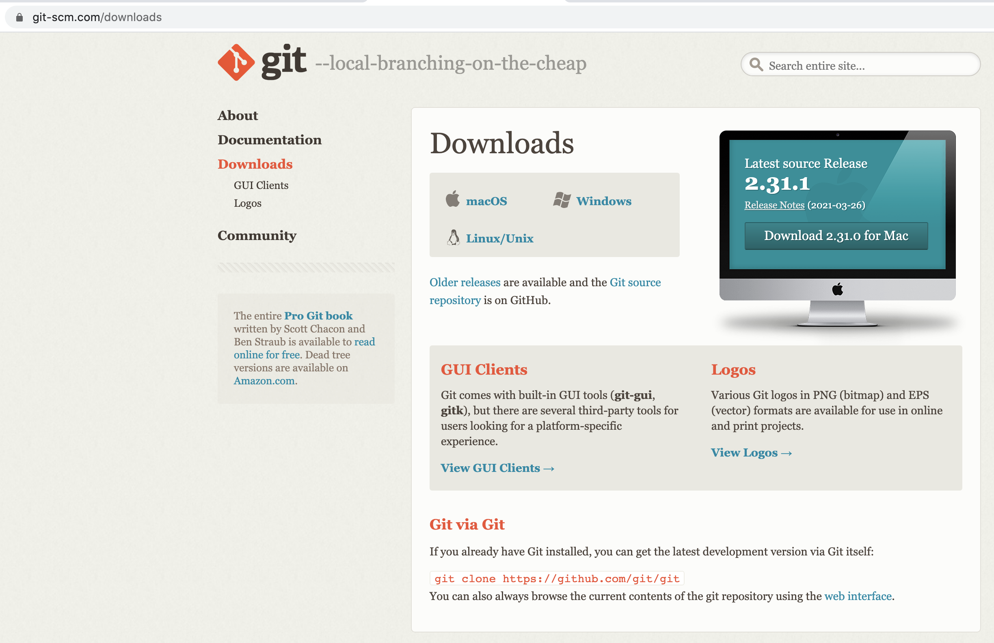
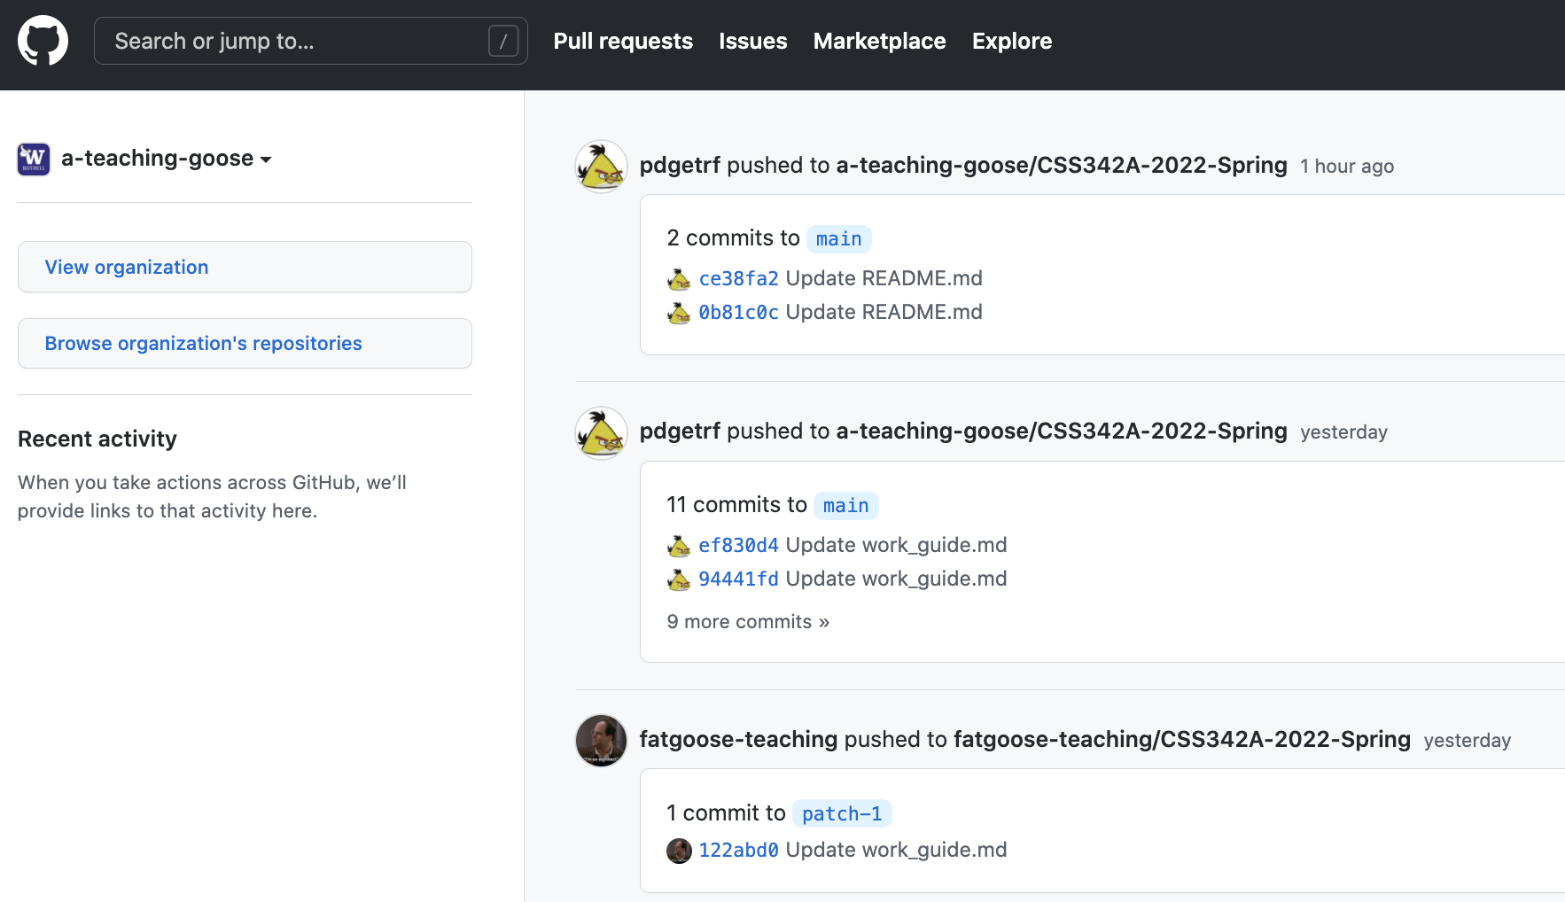
Git & Github
https://git-scm.com/downloads
https://github.com/

Slide 19
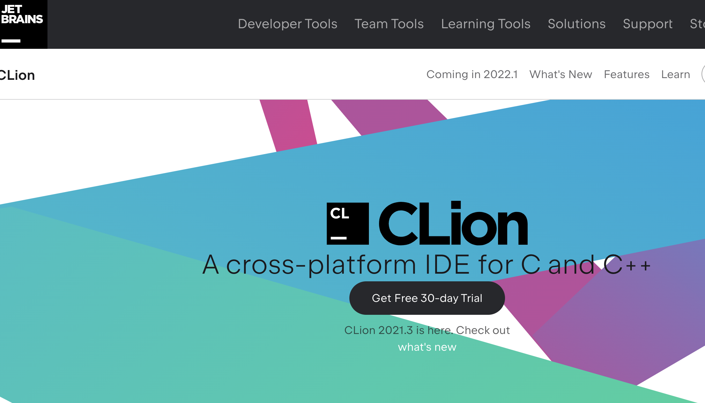
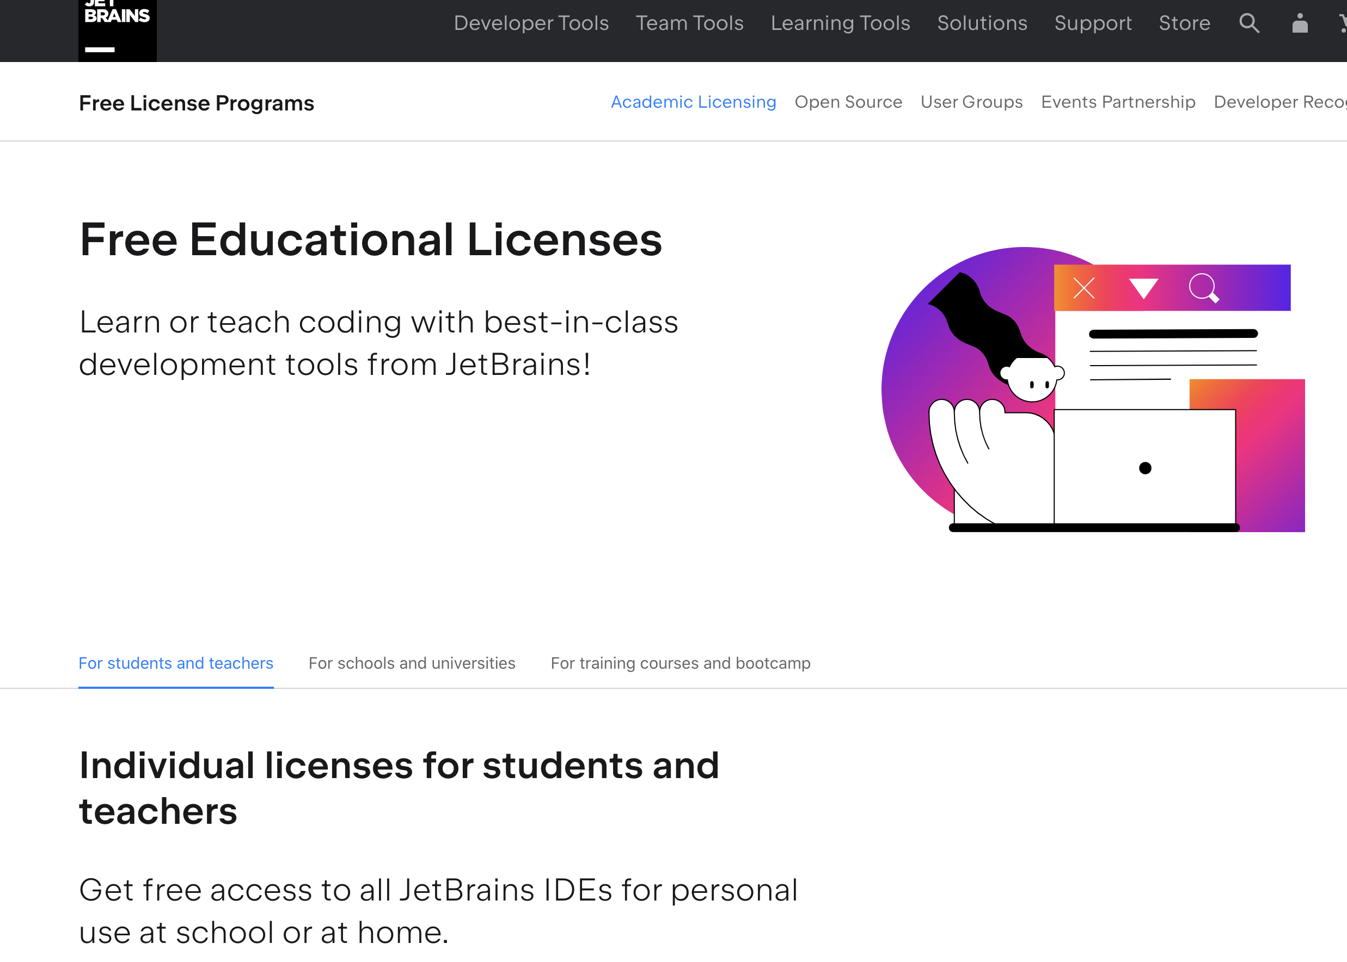
IDE
https://www.jetbrains.com/clion/
https://www.jetbrains.com/community/education/#students
Demo!

Slide 20
Homework

Slide 21
Expectation
This course will:
NOT focusing on teaching C++, but we will review the basics
Pointer & reference, class, template, OOP, etc.
NOT A math class, but we will touch some theoretical topics such as induction as formal proof

Slide 22
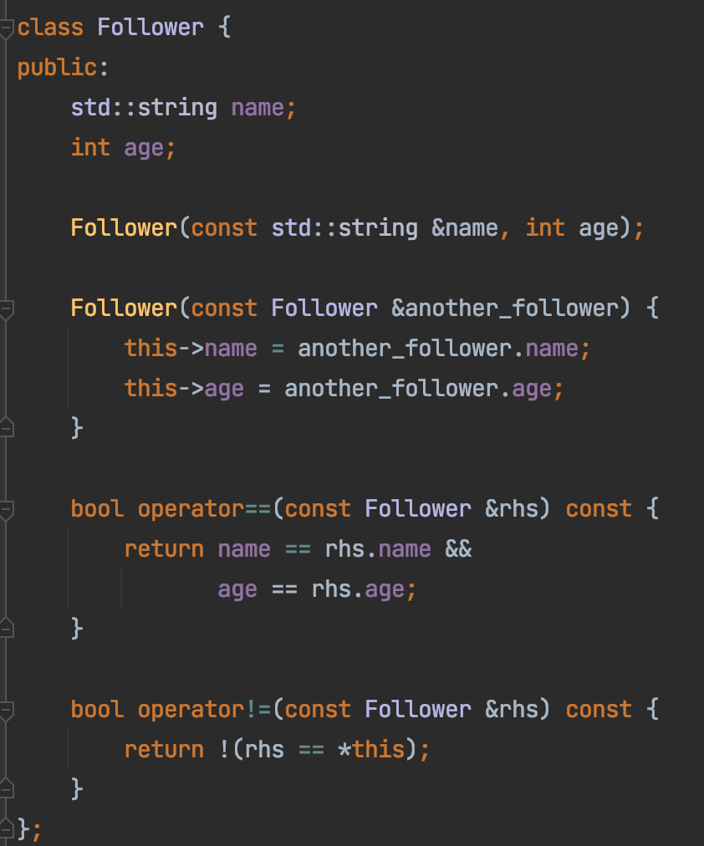
Coding Convention
Naming convention
Not strict
Bottomline:
Pick and follow a rule set
Be consistent
https://github.com/a-teaching-goose/2022-342-sprint-1/blob/main/src/problem_3.h

Slide 23
Coding
Avoid duplicates
No same logic more than once!
Comments
On intent, not action
Modular
Cohesion: 1 task per module
Coupling: As loosely coupled as possible
Variable Naming
Jacob’s guide

Slide 24
C++

Slide 25
A Correctness Problem
“Does it work?”
“Does it work all the time?”

Slide 26
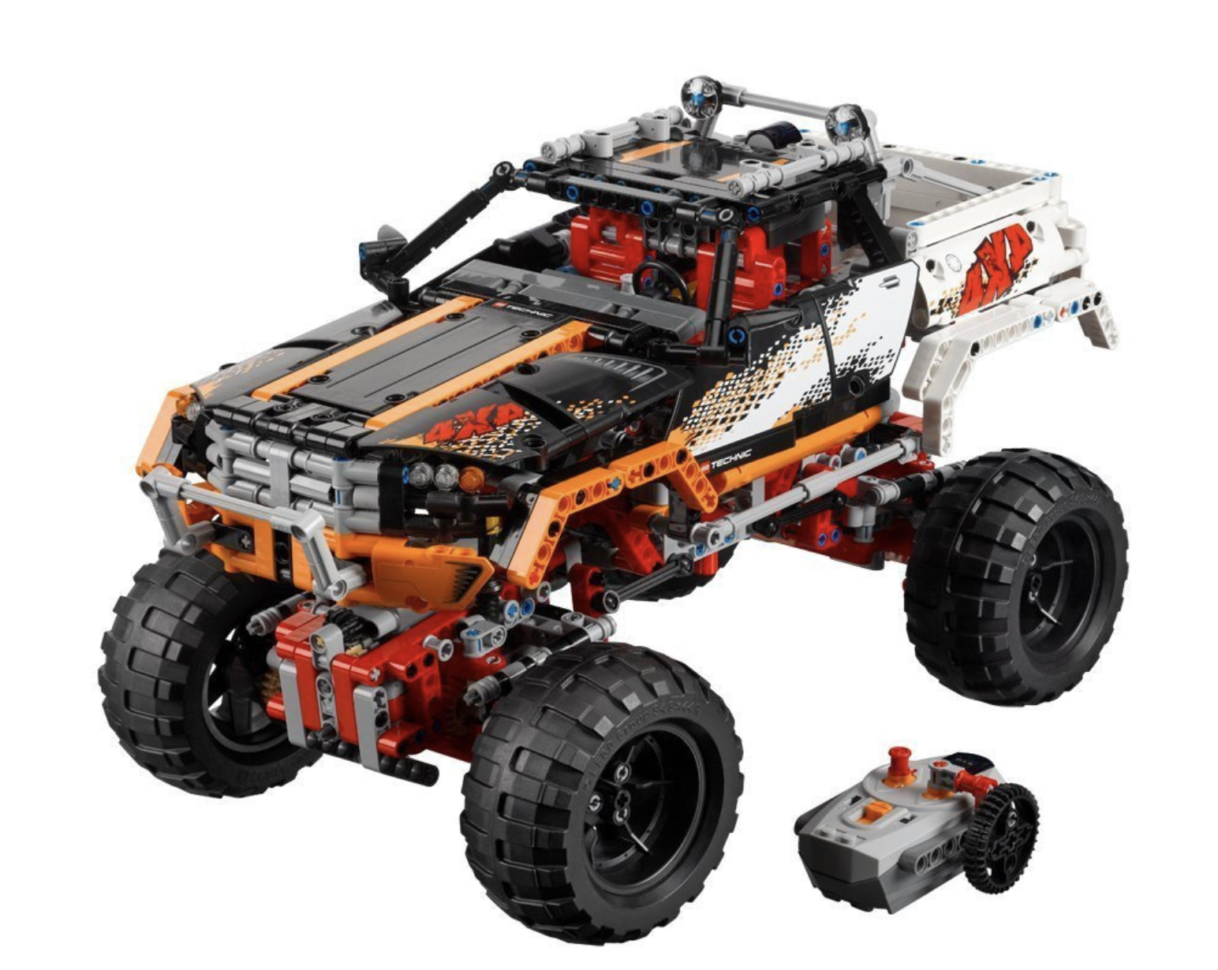
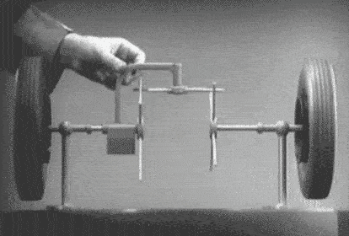
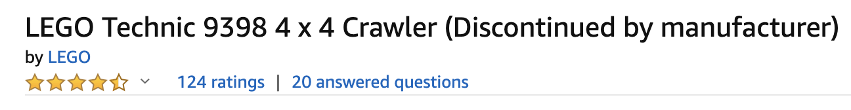
A Correctness Problem
Open Differential

Slide 27
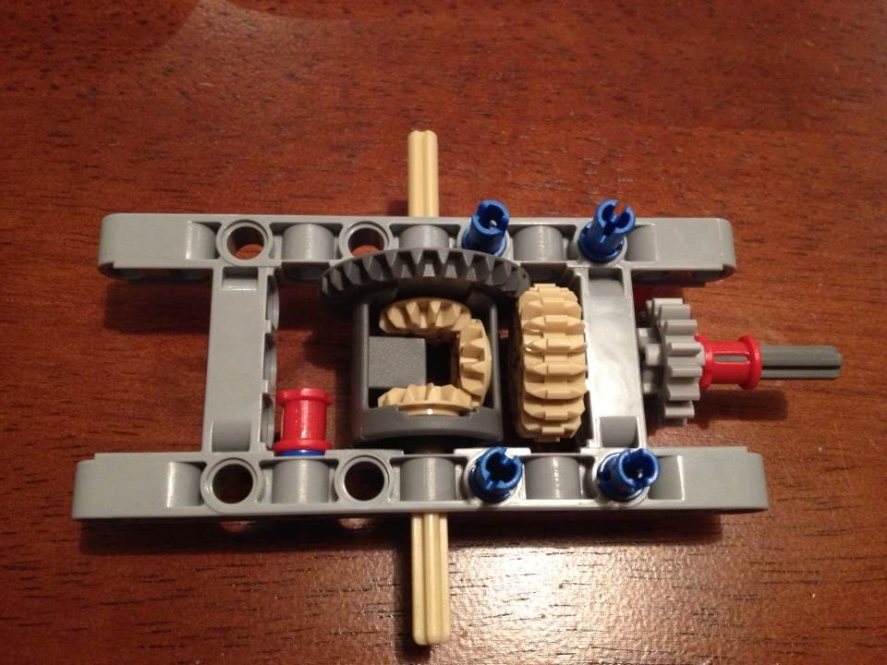
A Correctness Problem
Input:
Torque on drive shaft
Output:
Torque on wheel axles
How do you test this differential?

Slide 28
A Correctness Problem
Input:
Torque on drive shaft
Output:
Torque on wheel axles
Function:
Axles rotate independently
How do you test this differential?

Slide 29
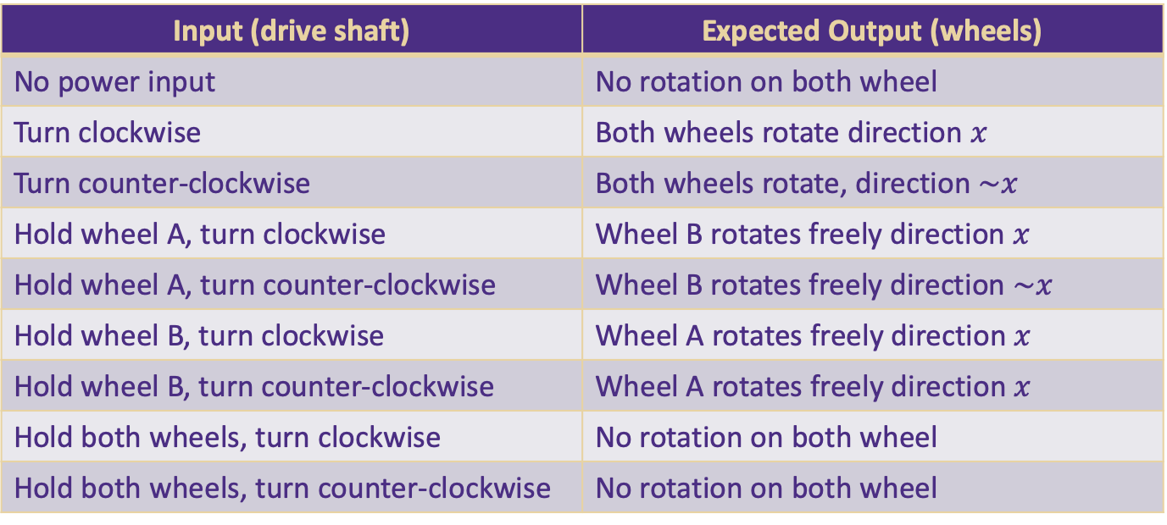
A Correctness Problem
Output: wheel A
input
Function To Test:
Axles rotate independently
Output: wheel B
Input (drive shaft) | Expected Output (wheels)
No power input | No rotation on both wheel
Turn clockwise | Both wheels rotate direction $x$
Turn counter-clockwise | Both wheels rotate, direction $\sim x$
Hold wheel A, turn clockwise | Wheel B rotates freely direction $x$
Hold wheel A, turn counter-clockwise | Wheel B rotates freely direction $\sim x$
Hold wheel B, turn clockwise | Wheel A rotates freely direction $x$
Hold wheel B, turn counter-clockwise | Wheel A rotates freely direction $x$
Hold both wheels, turn clockwise | No rotation on both wheel
Hold both wheels, turn counter-clockwise | No rotation on both wheel

Slide 30
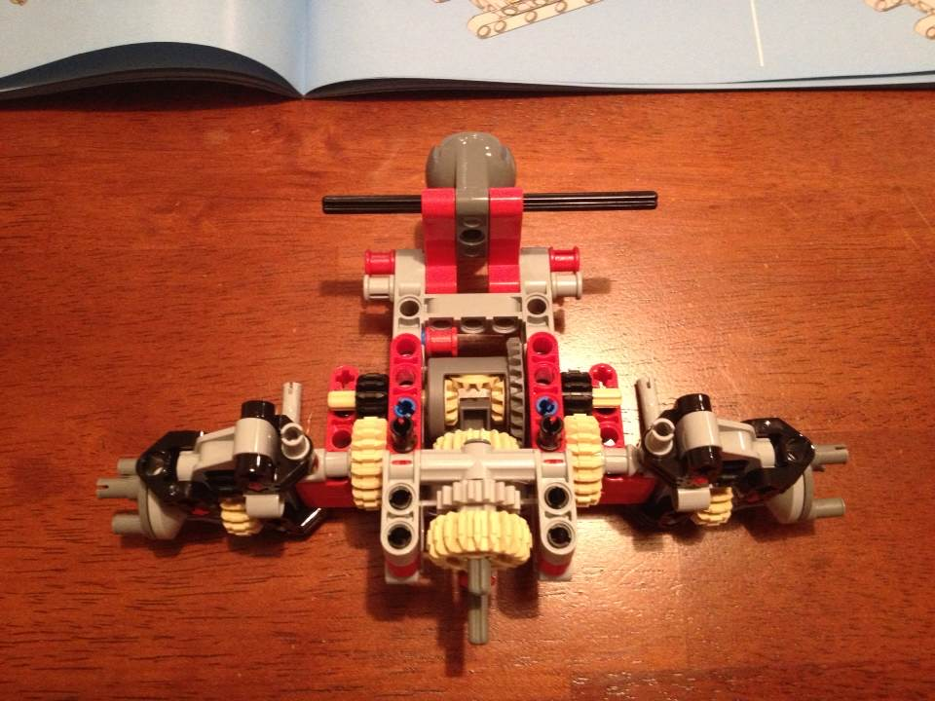
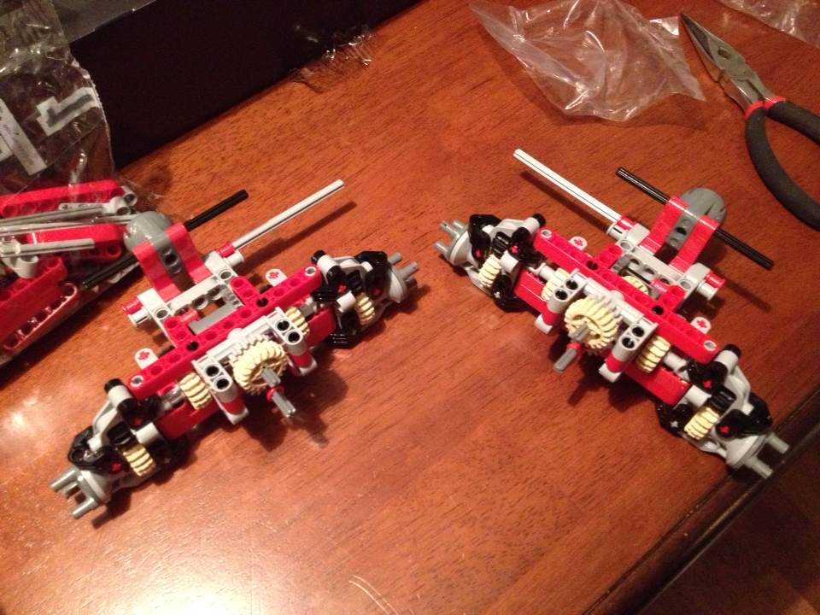
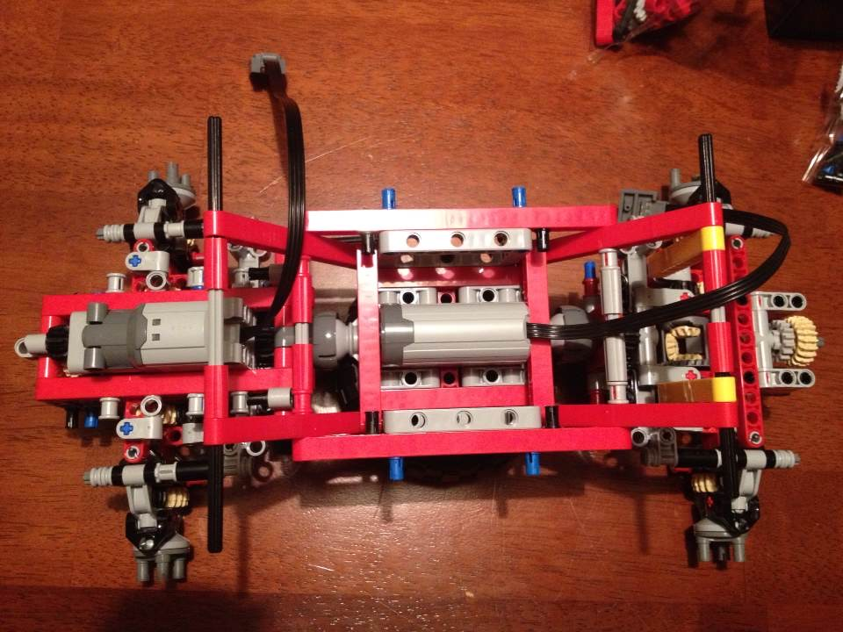
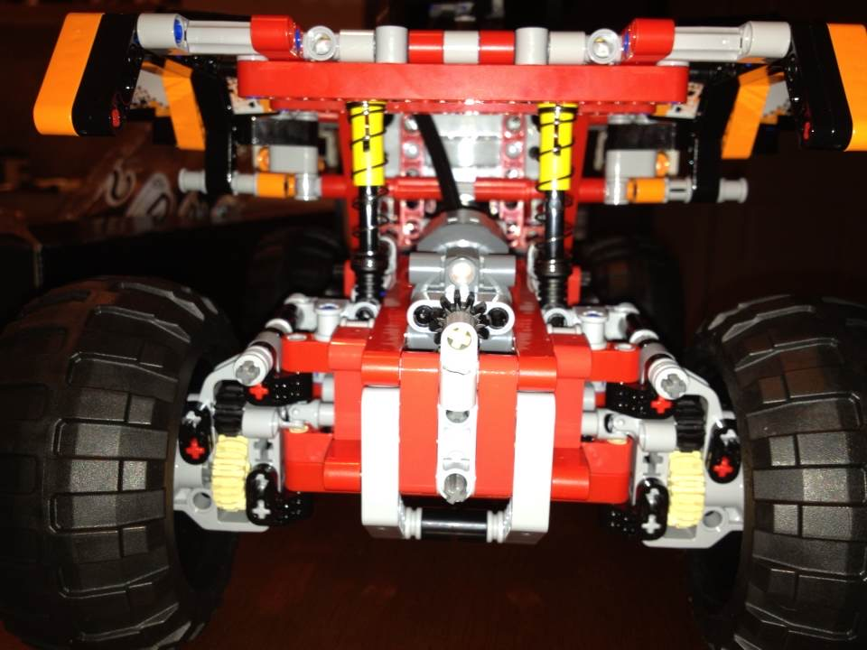
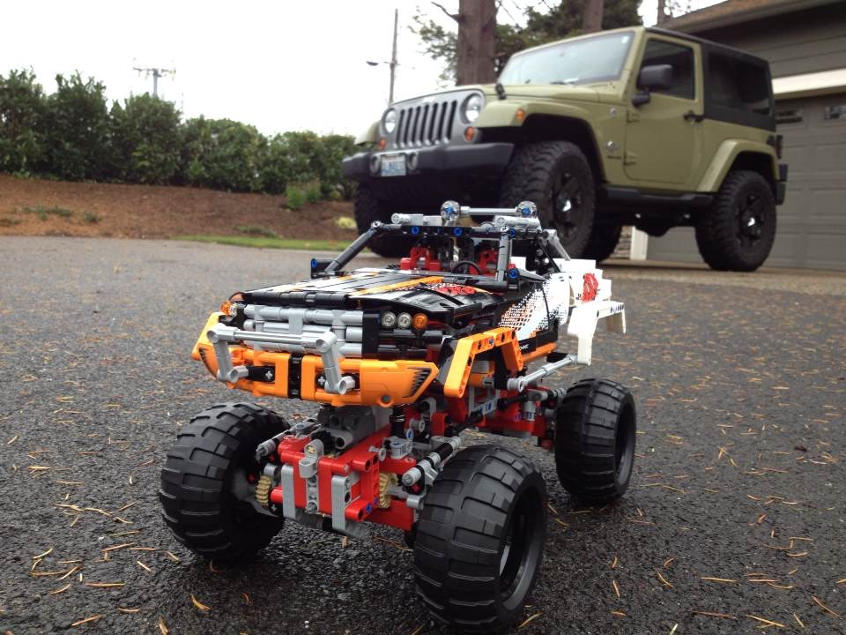
A Correctness Problem

Slide 31
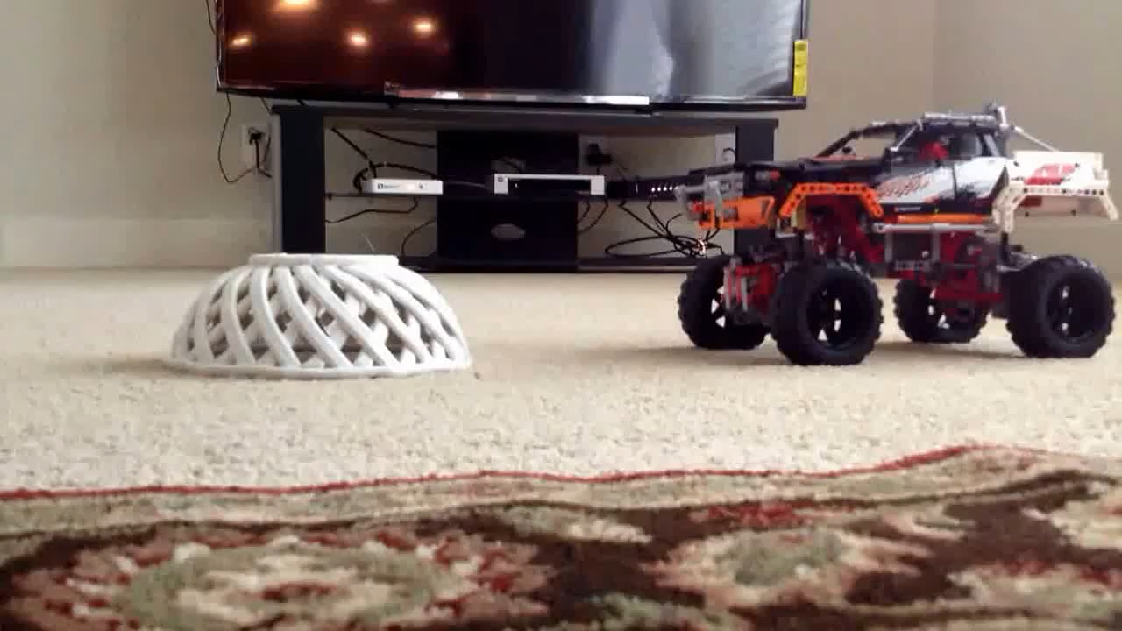
A Correctness Problem
Testing
Unit test
Integration test
Math Proof
Math Induction

Slide 32
Test Drive Development

Slide 33
Homework

